Slide 1

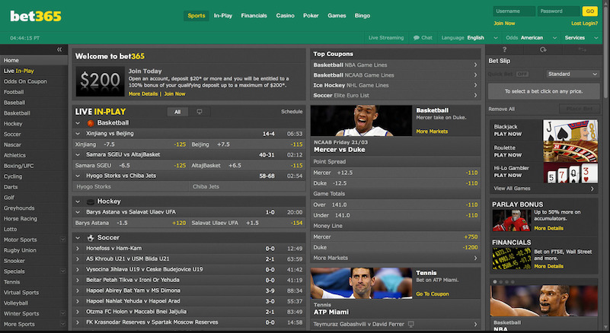
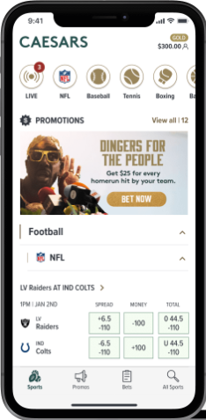
Sports Betting in US
-Industry Analysis
Group 2 - Andrew Rexford / Caleb Gould / Ryan Blais / Vicky Lasota

Slide 2
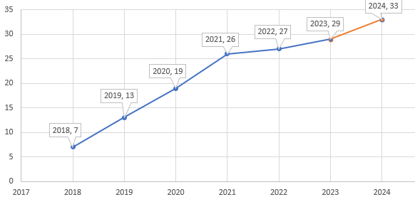
Executive Summary
Since the Supreme Court’s decision in 2018 to overturn ban on sports betting, dozens of states have legalized online and/or in-person betting.
As of today 29, states joined the betting boom increasing monthly revenues 14-fold since the first betting months of 2018.
Our group decided to share a snapshot of the changing industry.

Slide 3
Focus
Despite legalization, laws differ from state to state affecting the industry’s growth and tax revenues.
The factors our group will explore in more detail:
accessibility to placing bets
taxation of gambling income

Slide 4
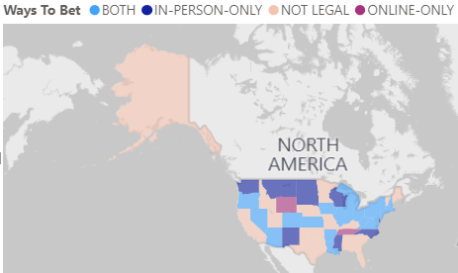
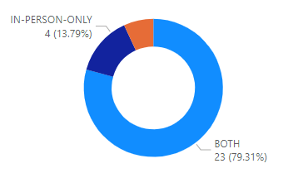
National Data
1
As of June 2023:
23 states legalized both in person and online betting
4 states allow in-person- only betting
2 states allow online-only betting
17 states still consider sport betting illegal
4 states are preparing to vote on legalization

Slide 5
Revenue Growth
1
Top 5 revenue generating states:

Slide 6
Tax Revenues
Explain why you’re focusing on a particular part of the problem or a particular subset of users.
82%
Users are constantly searching for a solution

Slide 7

Revenue per person
Julia
Team Manager
Reference your personas, if you have them.
Describe the content of Julia’s job and the problem she and her team are currently facing.

Slide 8
Use cases / user stories
Use cases, user stories, notes to set up the wireframes. Such as…
“As an Administrator, I would like to restrict permissions based on role.”
“As a Moderator, I would like to flag and approve comments.”
Executives indicated that being able to see a summary of each segment of data was their #1 priority.
Note: secondary admin workflow not planned for this release.

Slide 9
Assumptions
State your assumptions or any unknowns here.

Slide 10
Solution Proposal

Slide 11
Solution description
Now that you’ve justified your attention to the problem, summarize your solution in one or two sentences.

Slide 12
Why it’s better than existing solutions
Return to the problem now that you’ve introduced your solution. Compare your solution to others and describe how it is superior.

Slide 13
Wireframes

Slide 14
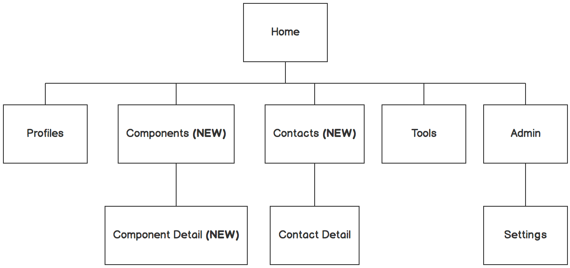

Information architecture
Balsamiq Tip | Information architecture is the flow of content across the site or application (more info).

Slide 15
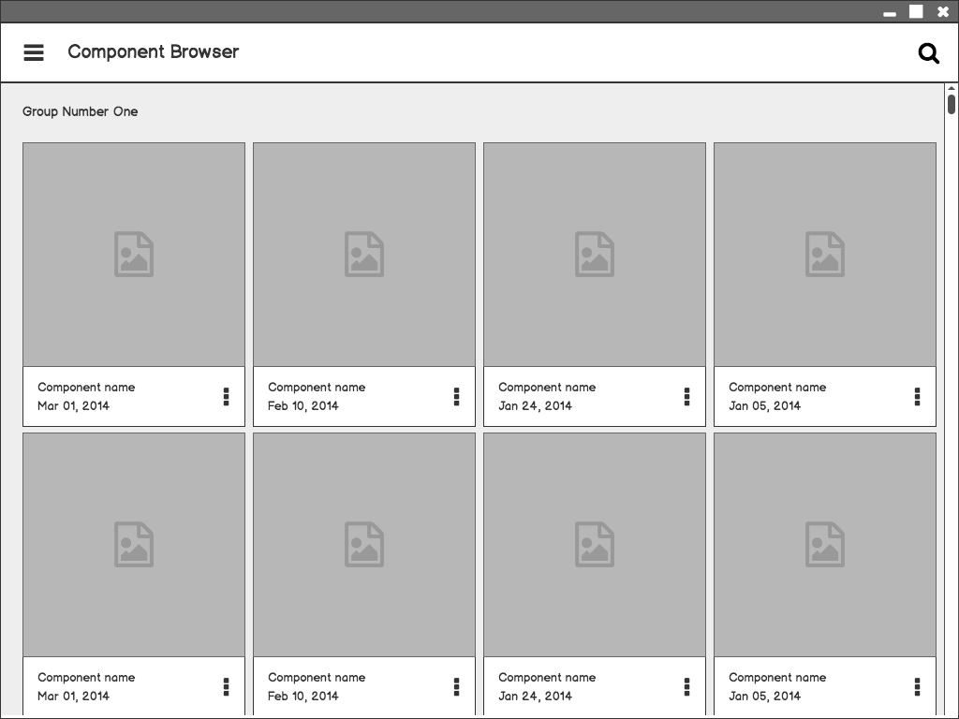
Component Browser
Call out key parts of the UI
Balsamiq Tip | Use the Balsamiq add-on to make your own wireframe.

Slide 16
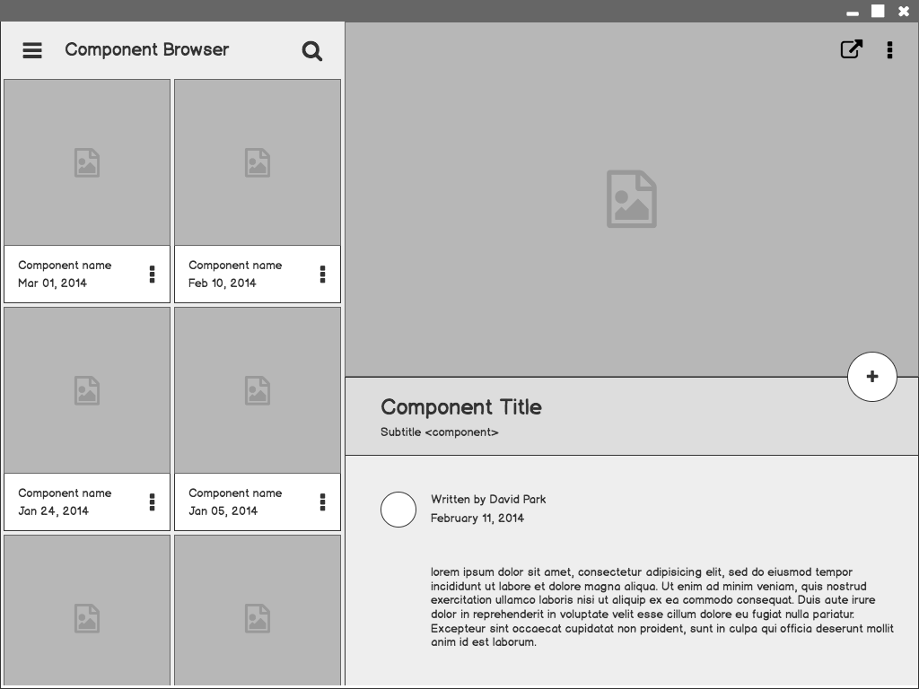
Component Detail

Slide 17
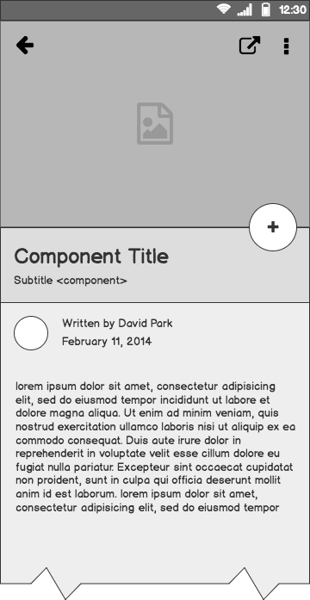
Component Detail (Mobile)
Articulate your design decisions by adding justifications

Slide 18
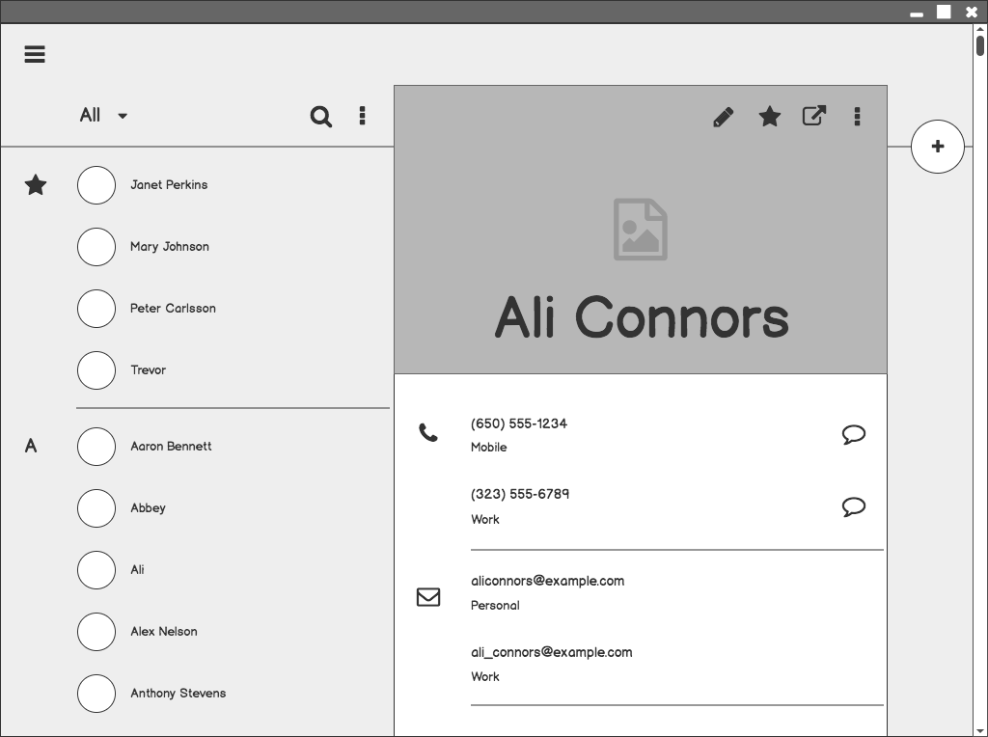
Contacts

Slide 19
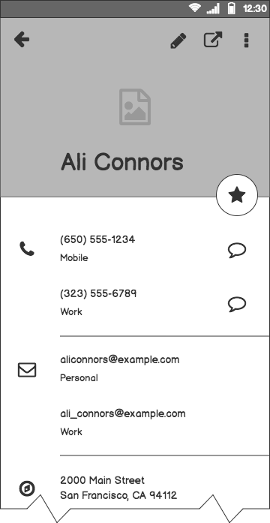
Contacts (Mobile)

Slide 20
Next Steps

Slide 21
What next?
Present the timeline.
Solicit comments on these slides or reviews on these wireframes in the Balsamiq add-on.
User testing plan.

Slide 22
Timeline
MAY
JUN
TODAY
AUG
SEPT
OCT
NOV
Requirements gathering
User research
Wireframes
Review
Prototype
User testing
Dev hand-off

Slide 23
Questions?

Slide 24
References
Tips for Presenting Your Wireframes
3 Steps to Better UI Wireframes
Wireframing for Beginners

